Slide 1
NSTU Academia
A Hassle Free System for University Students
Team A
Members:
Yeasin Arafat(ASH2125013M)
Arpita Majumder(BFH2125015F)
Mohammad Junaid Hossain(MUH2125012M)
Adiba Ahmed Tiasha(BFH2025034F)

Slide 2
Introduction
With the help of a powerful course registration system, we hope to simplify the educational process for students. With the help of an intuitive interface, students will be able to register for courses, check the availability of seats, and apply for a seat in hall. Our goal is to provide a system that is not only effective but also fair and available to all students.

Slide 3
Objectives
Simplify Academic Tasks
Ease Administrative Work
Provide User-Friendly Access
Keep Data Accurate
Improve Communication
Save Time and Effort
Support Growth
Offer Easy Access
Ensure Data Safety
Reduce Paperwork

Slide 4
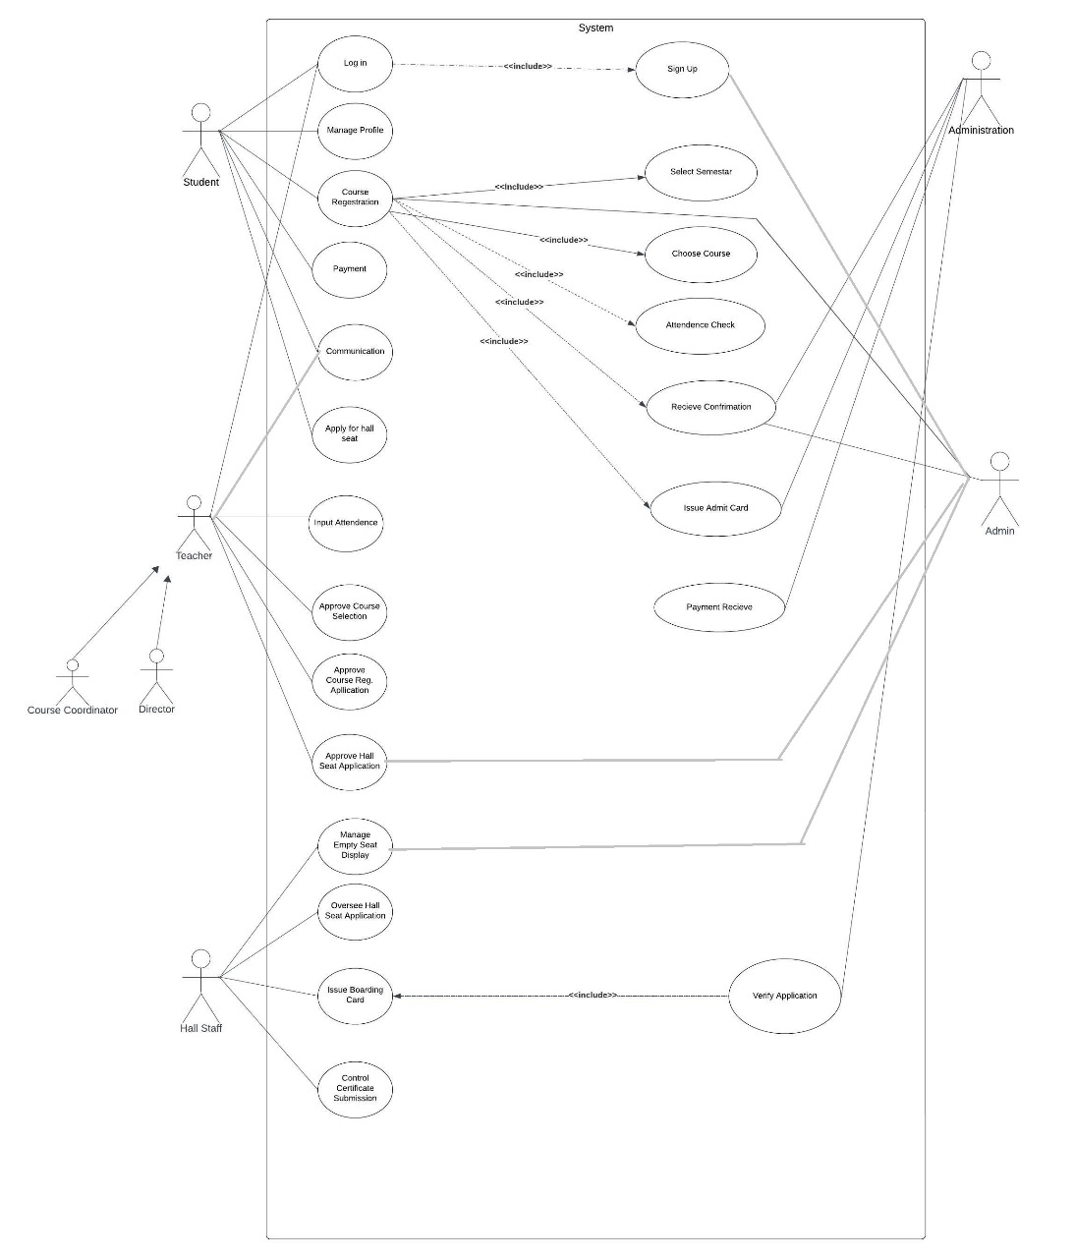
Usecase Diagram

Slide 5
Functional Requirements
1. User Management:
Allow role-based access for students, administrative staff, and teachers.
Enable users to perform actions relevant to their roles (e.g., course registration for students, and approval processes for staff).
2. Core Functionalities:
Course Management: Handle course registration, selection, and approvals efficiently.
Hall Seat Management: Manage hall seat applications, approvals, and availability displays.
Attendance Management: Input and maintain attendance records accurately.
Admit Card Issuance: Automate generating and issuing admit cards.

Slide 6
Functional Requirements
3. Data Handling:
Verification: Ensure secure verification of student applications, payments, and certificates.
Record Keeping: Maintain up-to-date and accurate records for registrations, payments, and hall allocations.
4. Communication Features:
Facilitate smooth communication between stakeholders (e.g., notifications and updates).
5. System Integration:
Ensure seamless integration between modules like payments, hall management, and course registrations.
6. Security & Validation:
Implement robust validation processes to maintain data integrity and prevent errors.
Protect sensitive information with secure role-based permissions.

Slide 7
Tools and Technologies
1. Development Tools:
XAMPP
MySQL
2. Programming Languages:
Frontend:
HTML
CSS
JavaScript
Backend:
PHP for server-side logic & database interaction
4. Diagram and Schema Design:
PlantUML
ER Diagrams
5. Tools for Documentation:
Microsoft Word
Microsoft PowerPoint

Slide 8
Database Design
The database nstu_academia is designed with 19 interrelated tables.
Admit: Stores admit card information for students. Primary key admit_id.
Attendance: Records attendance data for courses and students. Primary key attendance_id.
Blank_seat_status: Tracks the availability of blank seats in halls. Primary key status_id.
Boarding_cards: Manages boarding card details for hall residents. Primary key card_id.
Course: Contains course details, such as course name and attributes. Primary key course_id.
Department: Maintains department-related information. Primary key department_id.
Students: Stores student-specific data. Primary key student_id.
Teacher: Manages teacher-related information. Primary key teacher_id.
Users: Contains login credentials and user roles. Primary key user_id.

Slide 9
Database Design
Halls: Stores information about university halls.Primary key hall_id.
Hall_admins: Tracks admin details for managing hall-related tasks. Primary key admin_id.
Hall_applications: Stores hall seat application data. Primary key application_id.
IIT & IIT2: Reserved for department-specific or special data. Primary key iit_id.
Payment: Tracks fee submissions and payment history. Primary key payment_id.
Profiles: Maintains user details (e.g., students, staff). Primary key profile_id.
Registration: Links students with their course registrations. Primary key registration_id.
Seats: Manages detailed seat information for halls. Primary key seat_id.

Slide 10
Thank You

